Slide 1
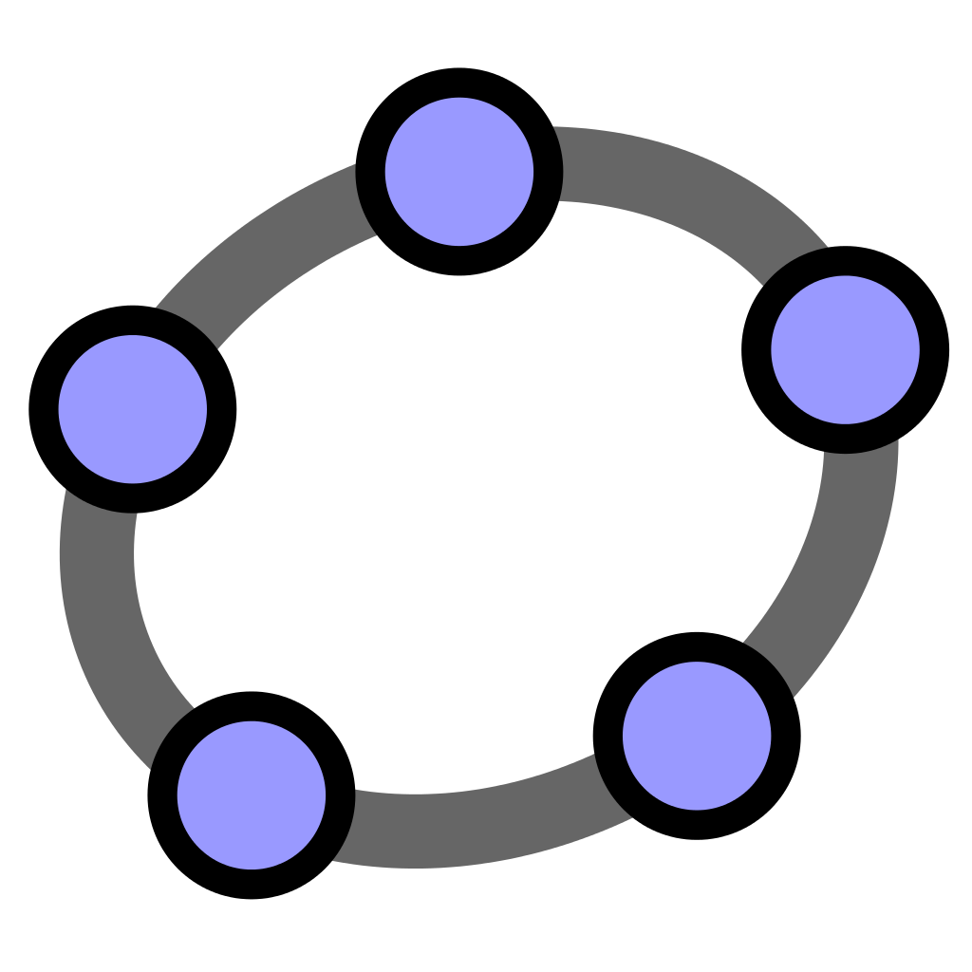
Maths with GeoGebra
August 11th 2022
monurl.ca/mstaugust1122
Domaine de la mathématique, de la science et technologie (MST)
This presentation, monurl.ca/mstaugust1122 of RÉCITMST, is made available, subject to exceptions, under the terms of the Creative Common License.
More détails : recitmst.qc.ca
Notes:
Link : https://monurl.ca/mstaugust1122

Slide 2
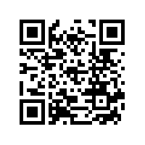
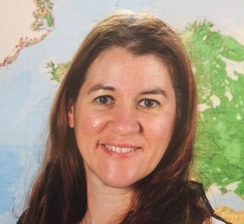
Sonya Fiset
sonya.fiset@recitmst.qc.ca
Note that Geogebra.org/ and all of its applications are open source and free resources.

Slide 3
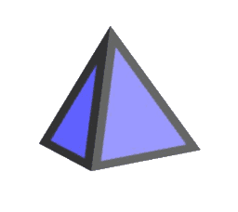
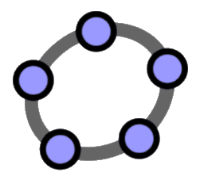
Workshop agenda
Presentation
Digital Comperency Framework
Site GeoGebra.org
Applications
Geometry
Graphing Calculator
Resources

Slide 4
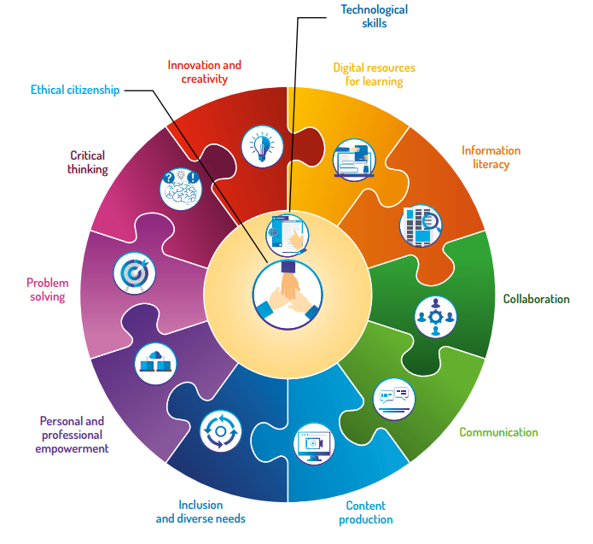
Digital Competency Framework
Link
Notes:
Pierre pourrait présenter directement cette page en anglais.

Slide 5
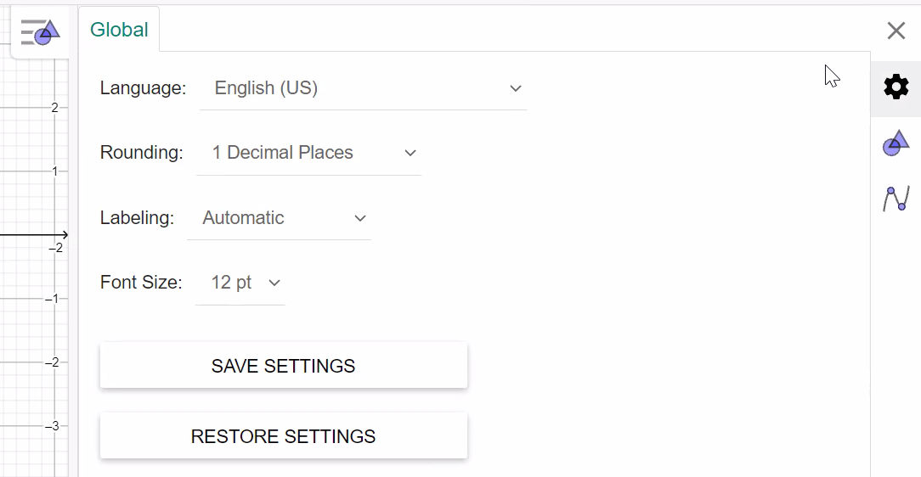
Language settings
1
2

Slide 6
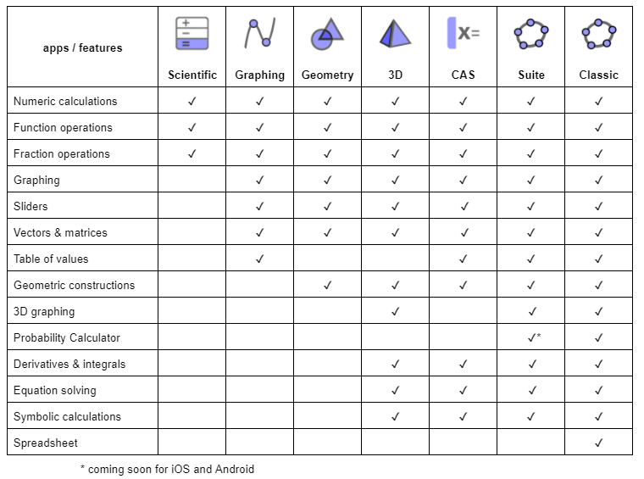

Slide 7
Geometry
Give students the opportunity to create

Slide 8
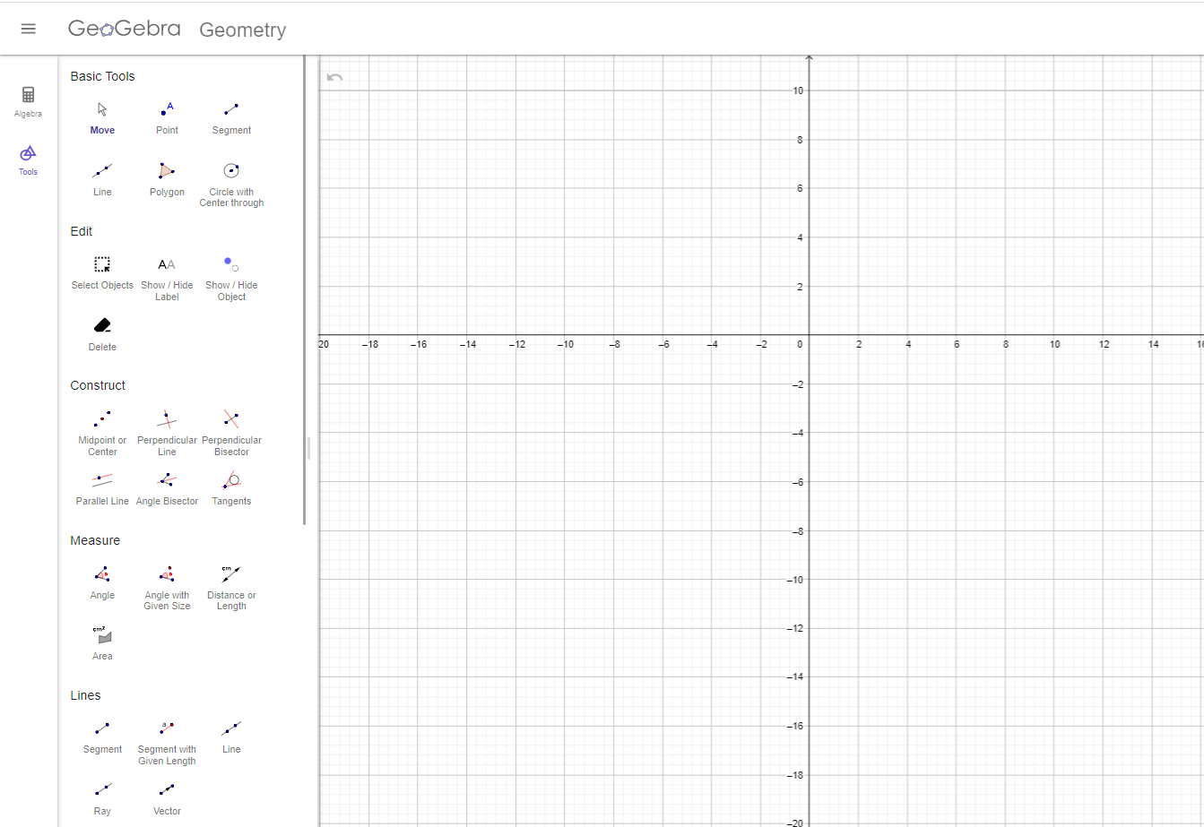
Basic Tools and MORE
Graph Windows
Challenges
Build a polygon
Show interior angle

Slide 9
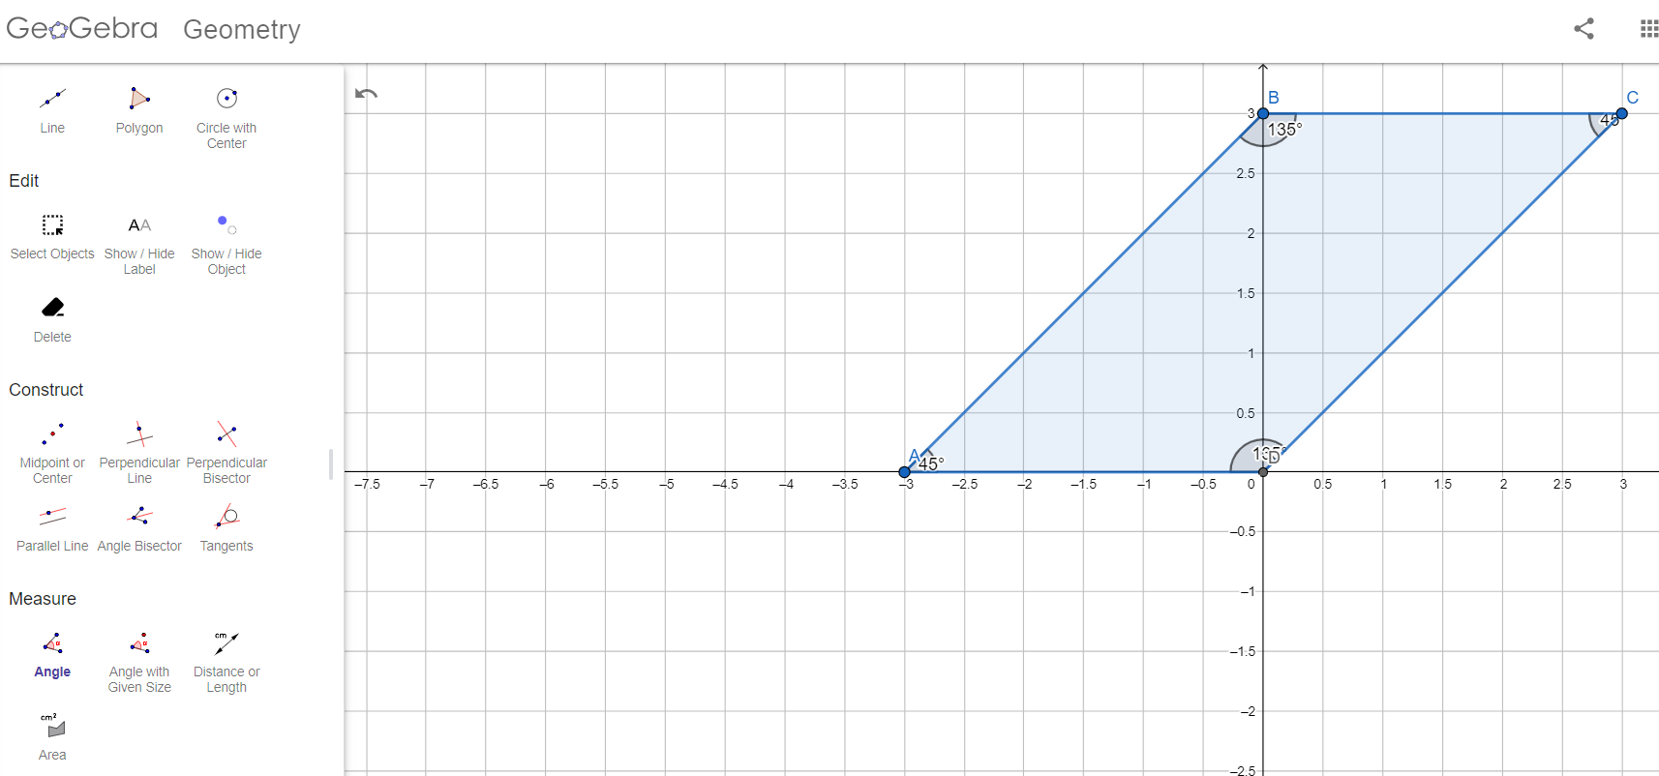
Example of a construction

Slide 10
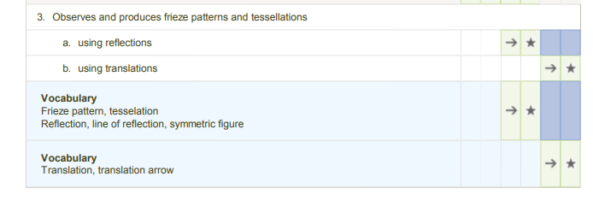
Time to explore
Advantages
Construction
Tools/ polygons
Construction
Algebra/ vertices
Fast
Clean work
Makes handling easier
Easy changes

Slide 11
Progression of Learning
Geometry
Space - Cartesian plane
Solids
Planar figures
Friezes and tessellations
Measure
Lengths
Angles

Slide 12
Graphing Calculator
Solve complex tasks by constructing functions and relationships

Slide 13
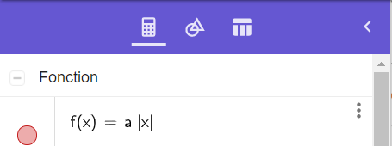
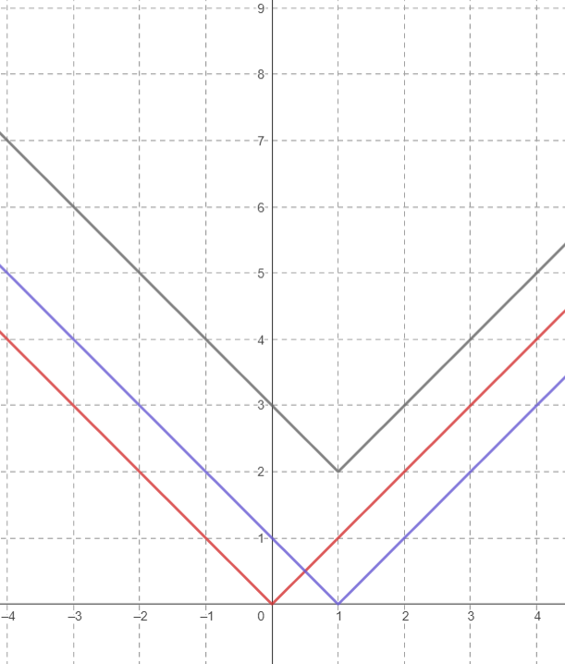
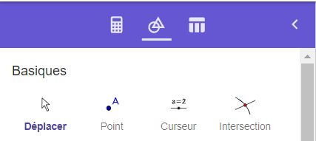
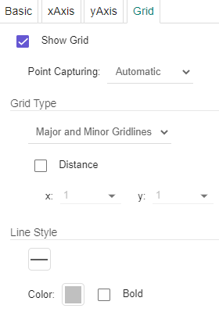
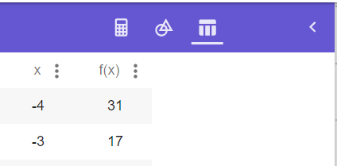
Algebra
Graph Windows
Tools
Proprieties
Table

Slide 14
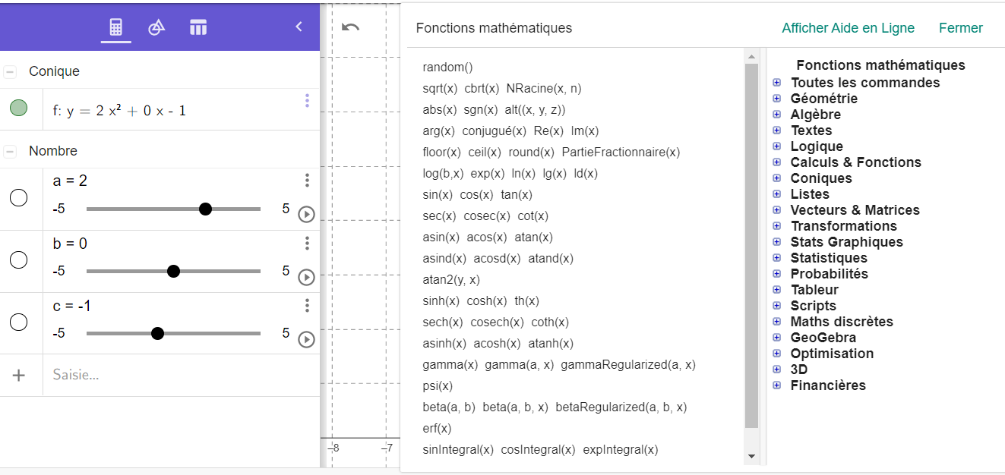
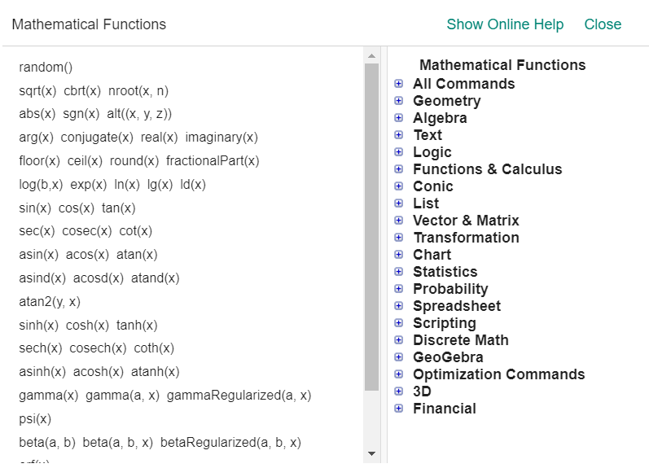
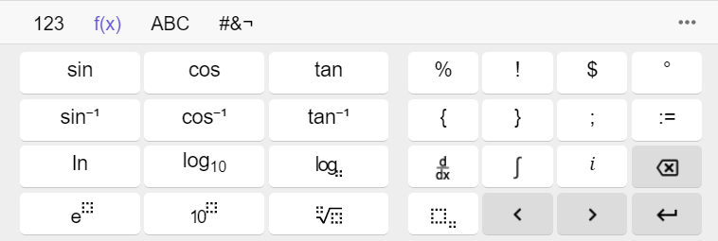
Many commands and functions
Four keyboards

Slide 15
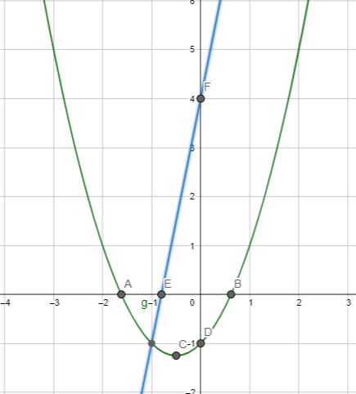
Challenge
Create a function algebraically
f(x)=5x+4
g(x)=x²+x-1

Slide 16
Resources
Tutorials
*GeoGebra Geometry App : Beginner Tutorials with Lesson Ideas
*Learn Graphing Calculator
Book Trigonometry
Trigonometric Functions
Tim Brzezinski Workshops

Slide 17
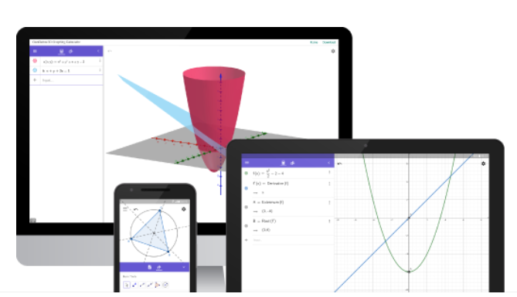
GeoGebra.org and exams
Information 1
Currently, it is not permitted to use this tool on ministry exams.

Slide 18
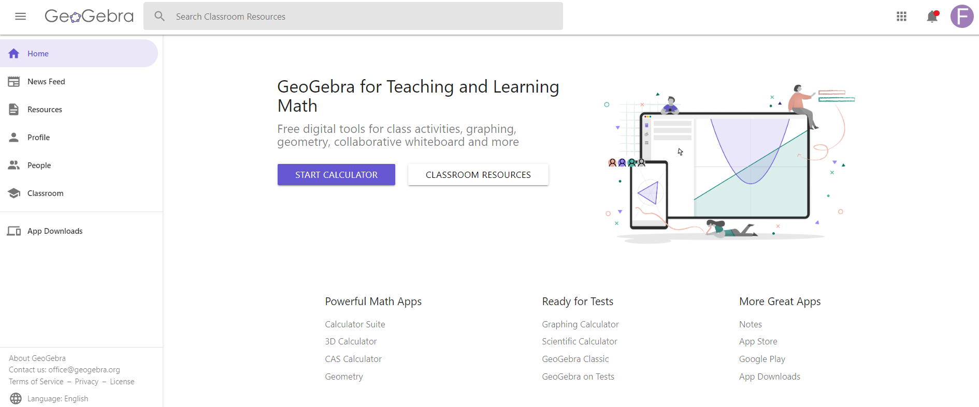
Le menu
Gestion du compte
Les applications

Slide 19
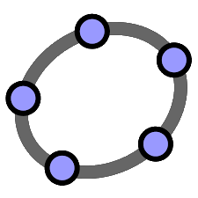
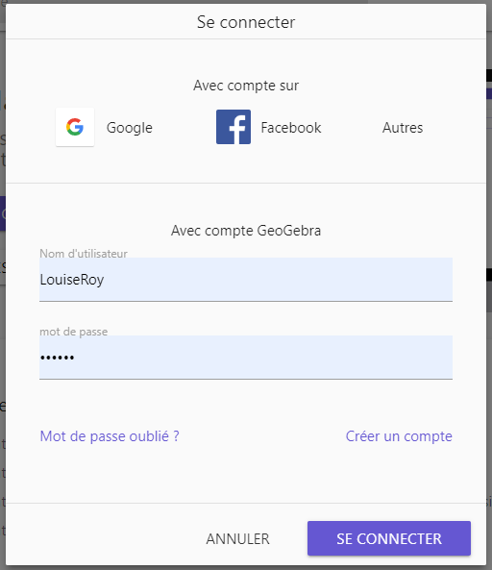
Création d’un compte
Having an account allows you to:
Save achievements online
Keep favorites
Create activities, booklets, classes and organize them
Broadcast, publish and share
Collaborate
Subscribe to other writers
Have subscribers
Livret de formation: https://www.geogebra.org/m/n9afhngr

Slide 20
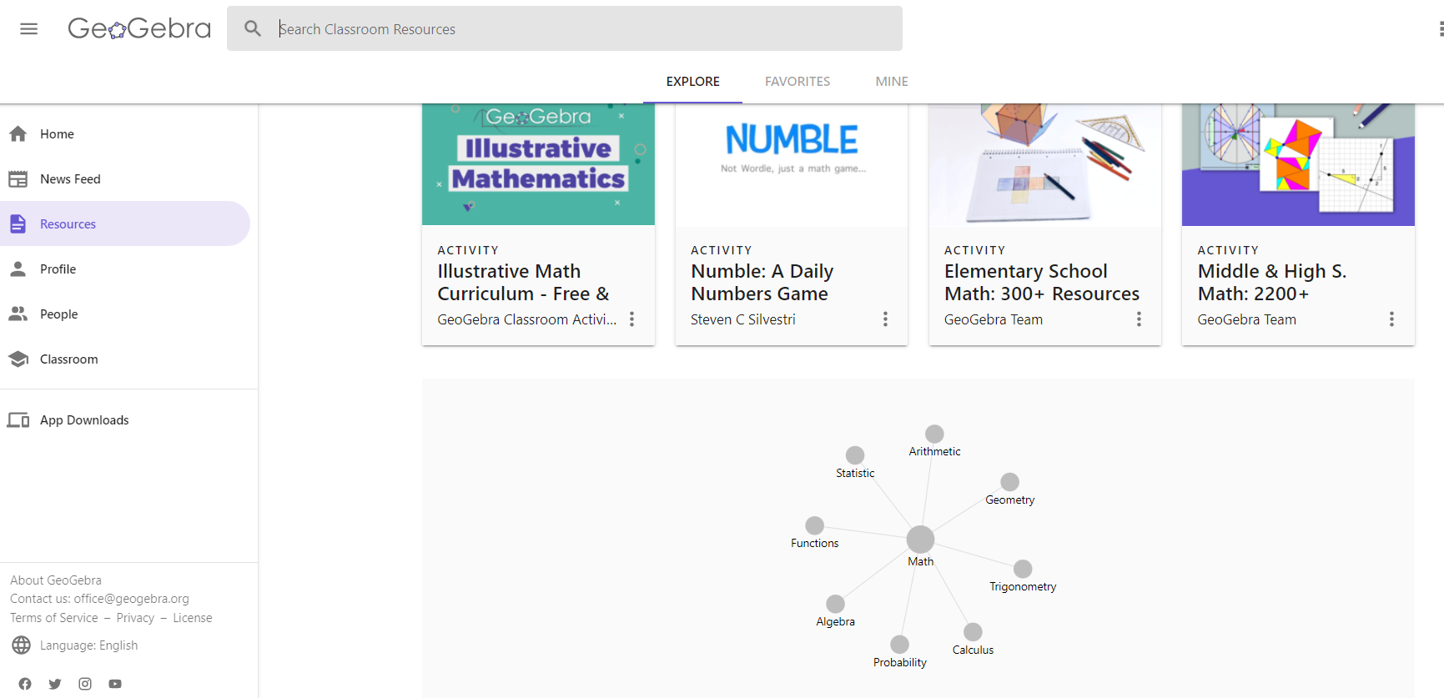
Resources
Search by keyword

Slide 21
Thanks !
Questions?
Sonya.Fiset@recitmst.qc.ca
equipe@recitmst.qc.ca
Facebook
Twitter
YouTube
This presentation, https://monurl.ca/mst21fev22, of RÉCITMST, is made available, subject to exceptions, under the terms of the Creative Common License.

Slide 22
Credits
Special thanks to all the people who made and released these awesome resources for free:
Presentation template by SlidesCarnival
Photographs by Unsplash

